Slide 1


Slide 2
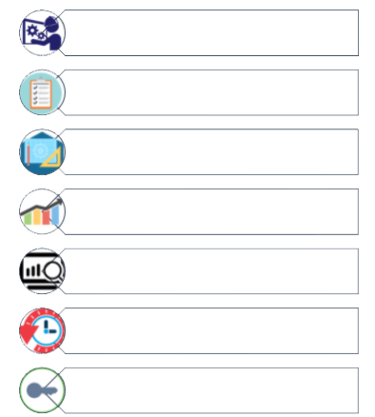
APPLICATION FEATURES

Slide 3
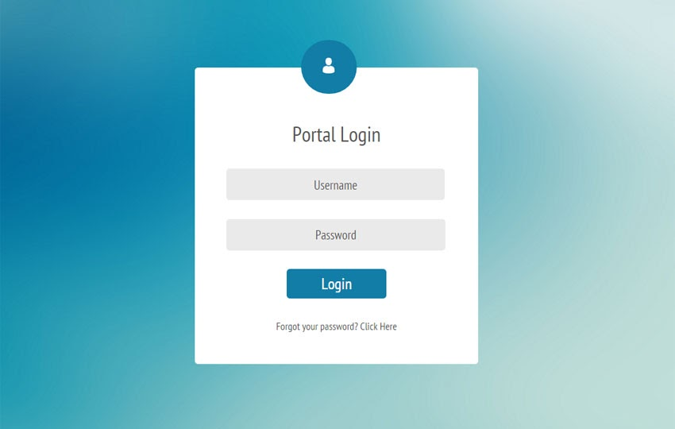
LOGIN

Slide 4
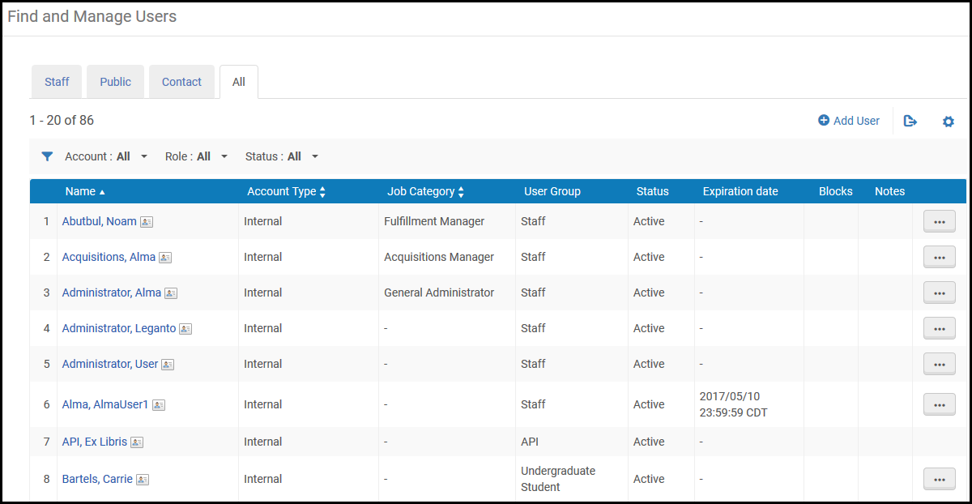
USER MANAGEMENT

Slide 5
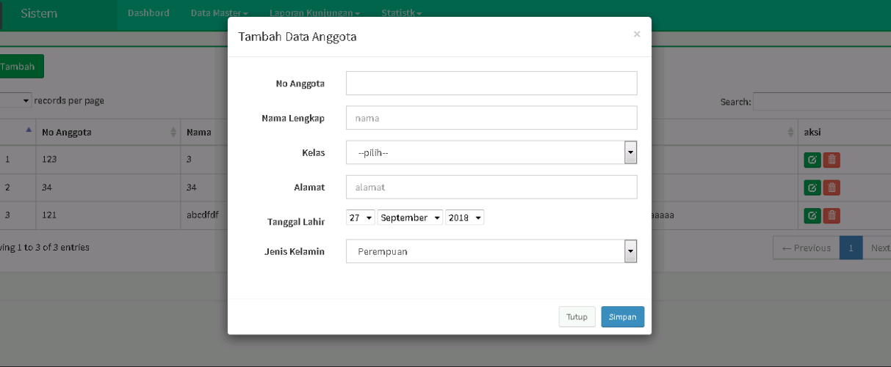
GUEST MASTER

Slide 6
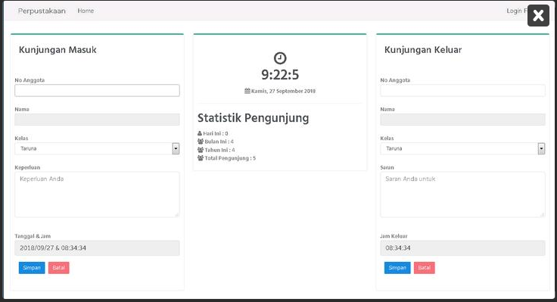
VISIT STATISTICS

Slide 7
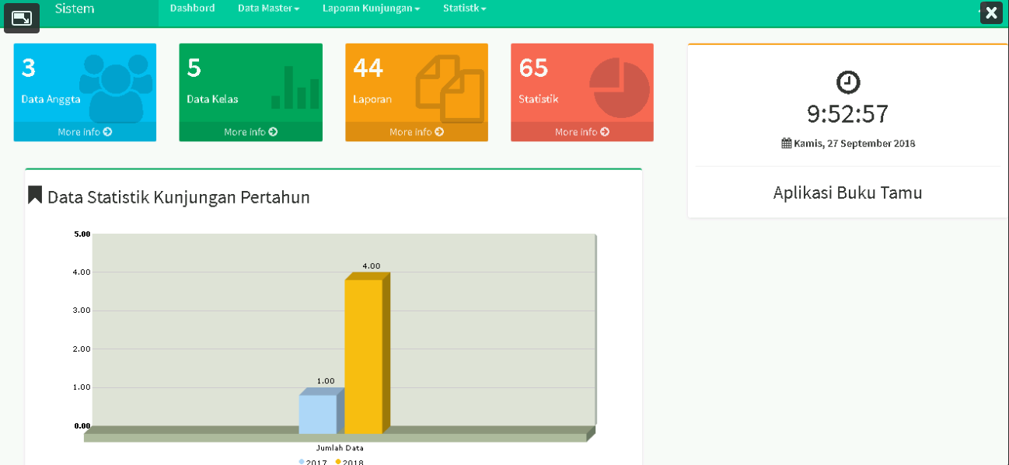
REPORTING

Slide 8
Thank you

